Slide 1

Die Junge Akademie | Mainz

Slide 2

The Institution

Slide 3
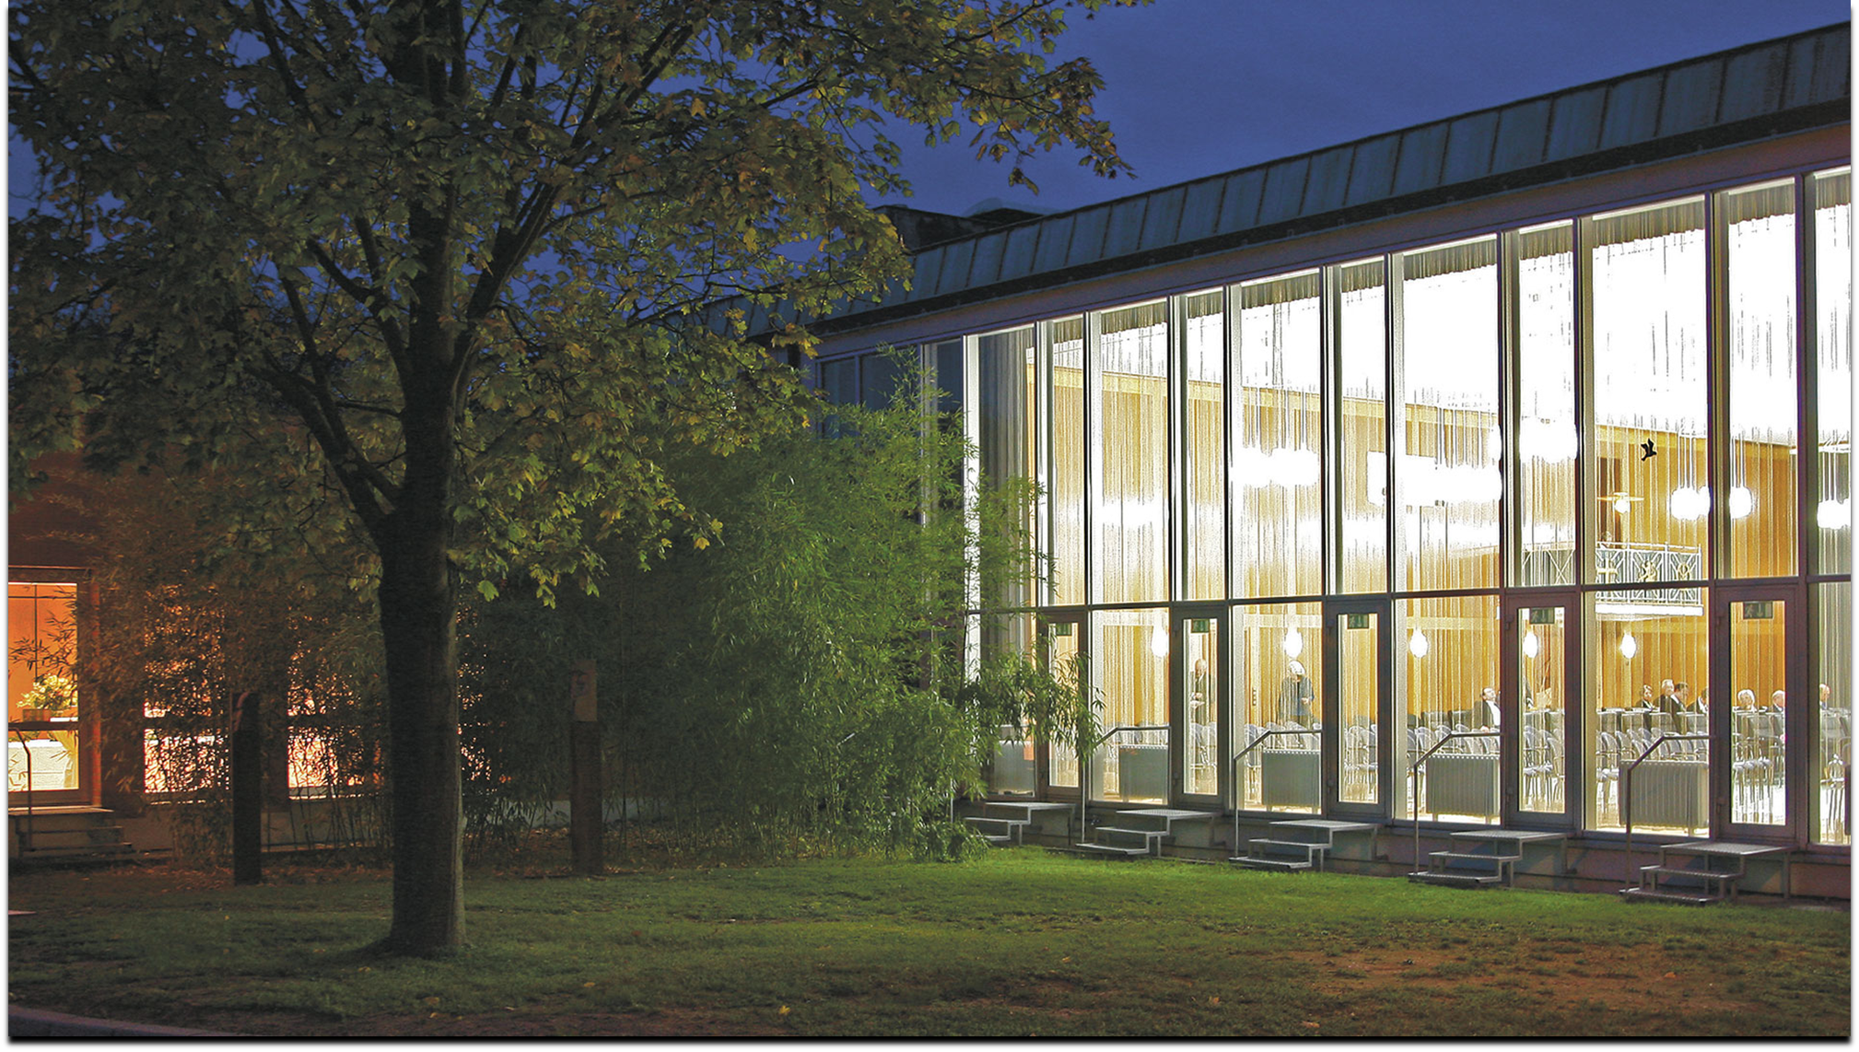
Die Akademie der Wissenschaften und der Literatur | Mainz
is a non-university research institution and learned society.
The aim of the academy is the cultivation of science and literature, and the preservation and promotion of culture.
In addition, it is dedicated to the promotion of young academics, the digitization of research data and the promotion of international cooperations.

Slide 4
Die Akademie der Wissenschaften und der Literatur | Mainz supports
excellent scientists, writers and musicians at an early stage of their careers through membership in the
Junge Akademie | Mainz
Interdisciplinary and intergenerational dialogue expands scientific networks of its members. The dialogue with the members of the established learned society is encouraged.

Slide 5

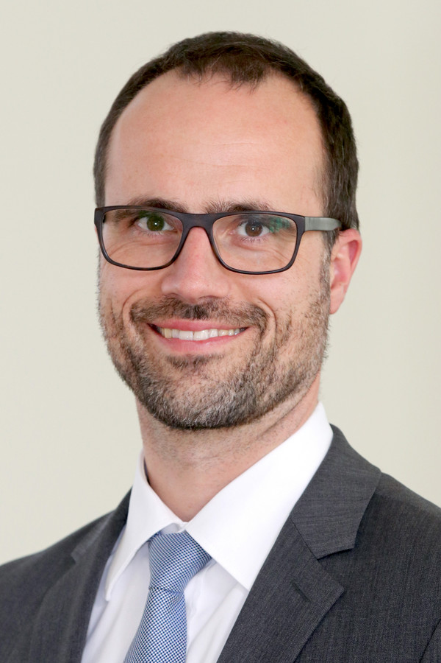
Funding
Funded by the Ministry of Science in Rheinland-Pfalz
Minister of Science and Health
Clemens Hoch serves as patron.

Slide 6




Cooperations
Werner Reimers Stiftung
Deutsch-Italienischen Zentrum für
Europäische Exzellenz Villa Vigoni
Deutschen Historischen Instituten
in Rom, Paris und London

Slide 7
Members of the
Junge Akademie | Mainz

Slide 8
Foundation and admission of the first generation
admission of the second generation
2016 2017 2018 2019 2020 2021 2022
36 members
50 members
Every 4 years there is a call for applications to become member of the Junge Akademie | Mainz.

Slide 9
Starting at the Junge Akademie | Mainz in 2020 …
A personal report:
The letter with my admission to become a member of the Junge | Akadmie Mainz came in late 2019. Our first meeting was scheduled for spring 2020, shortly after when the Covid19 pandemic started. For the first two years we had to meet exclusively online. At the beginning, the online meetings made it difficult to identify with the academy.
Neverthless, the staff of the academy (in particular, Aglaia Bianchi, let me use this opportunity to express a big thank you!) worked hard to make us all feel very welcome and helped us starting interactions and establishing working groups.

Slide 10
Facts and figures
The members are representatives
of various disciplines.
34 are social scientists and humanities scholars,
8 are writers and musicians,
8 are mathematicians or from the natural sciences
26 of the 50 members are women and 24 are men.

Slide 11
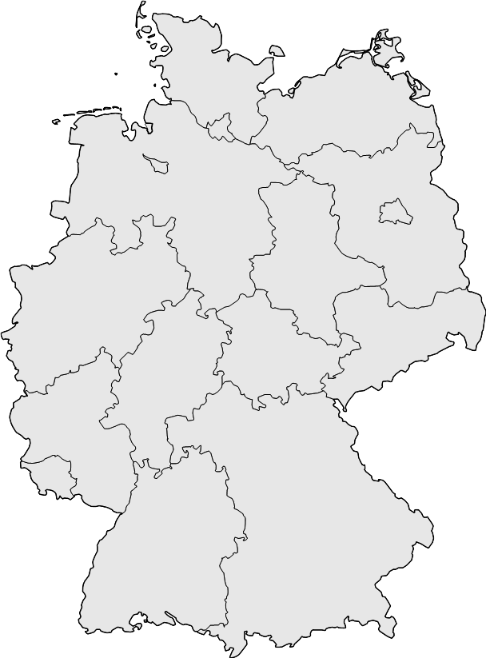
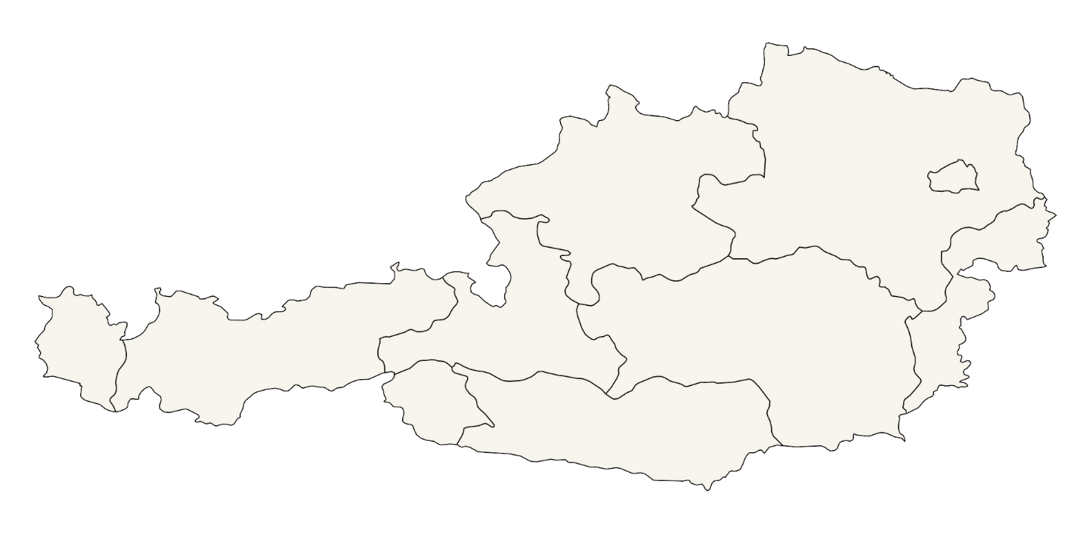

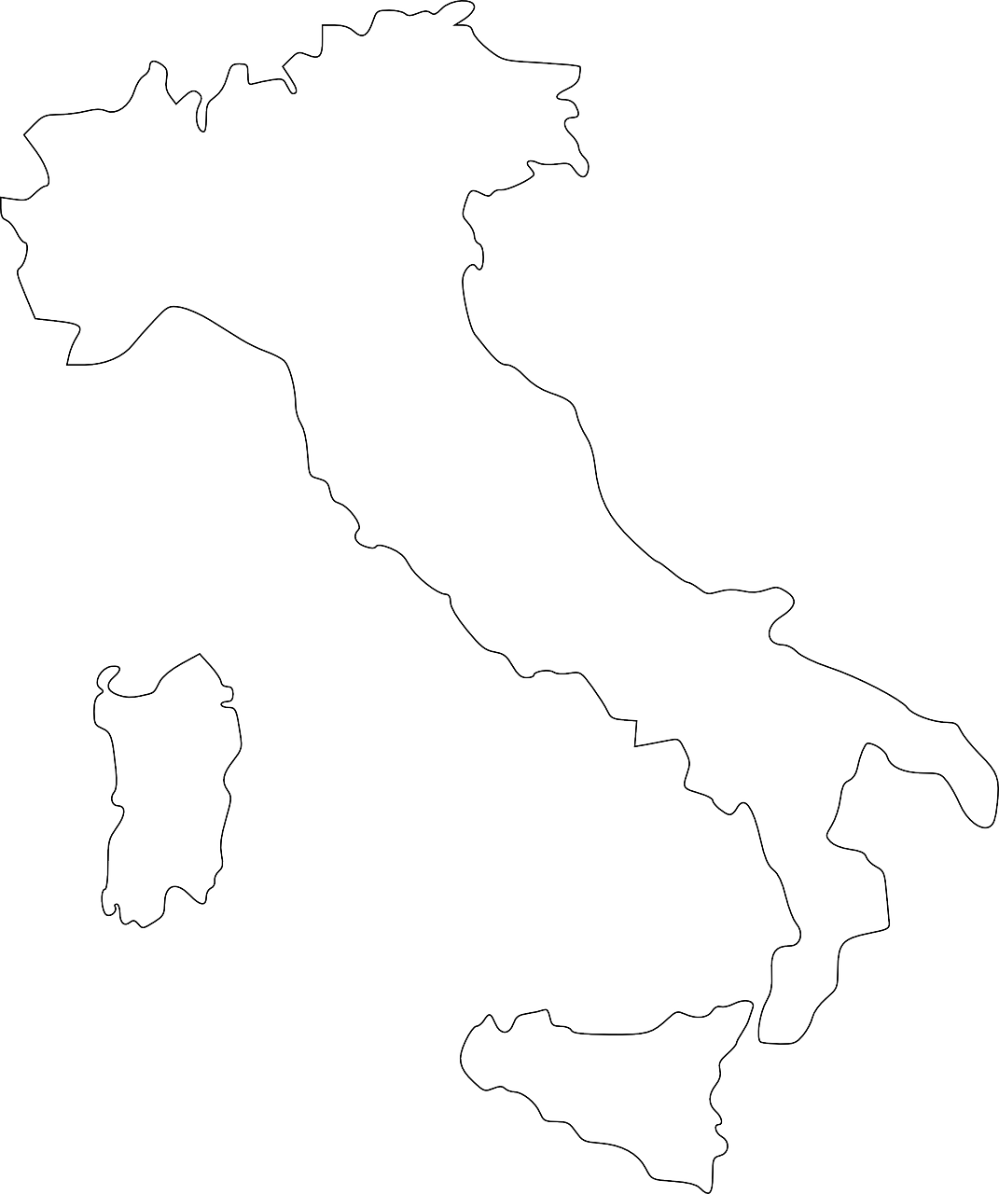
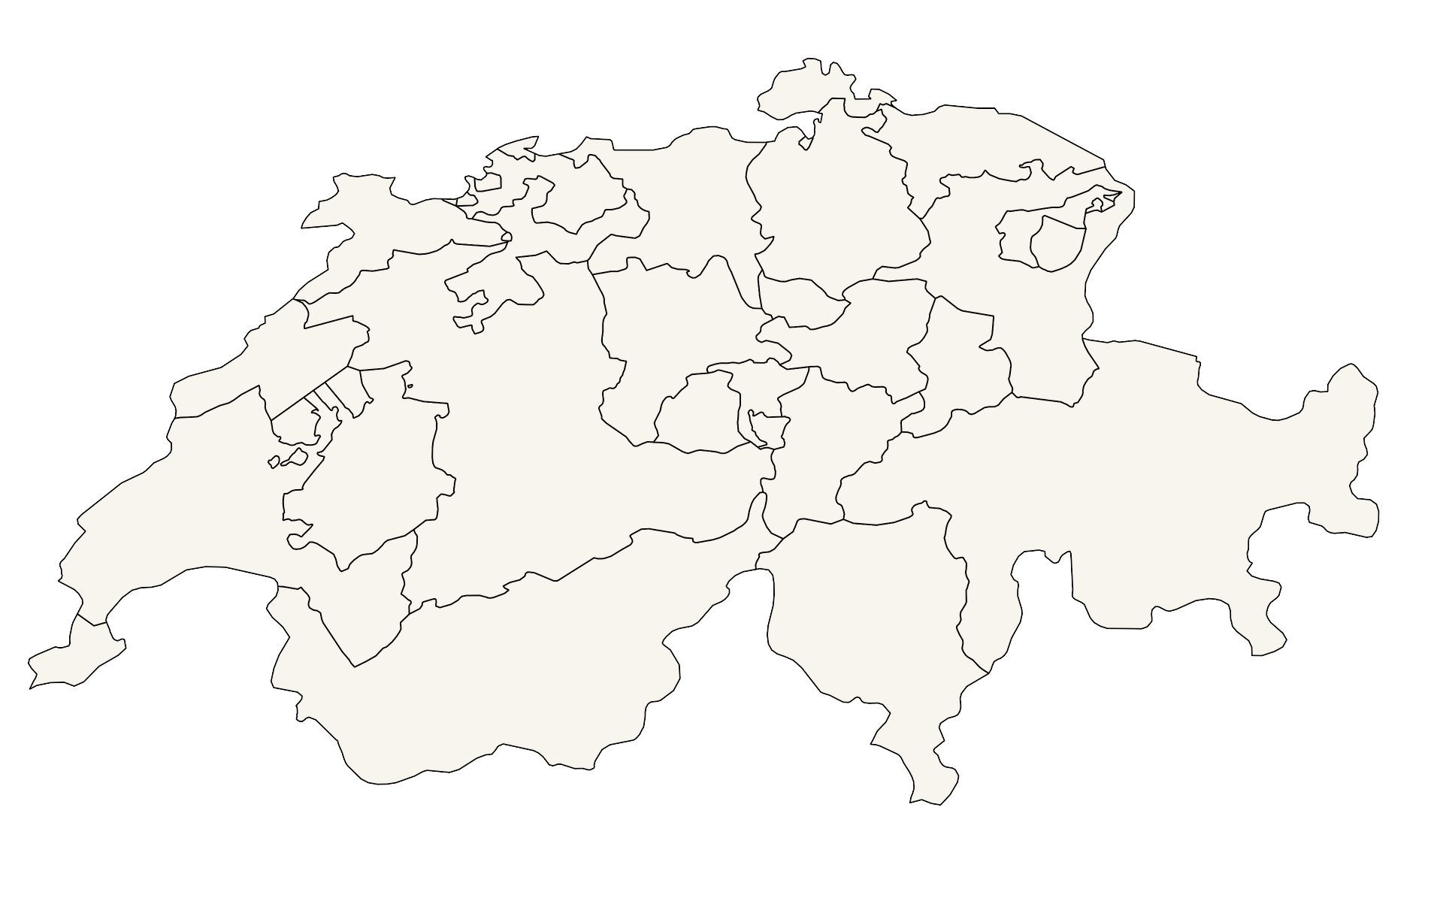
The members come from all over Germany and from Austria, Italy and
of Switzerland.
Austria
Italy
Switzerland

Slide 12
social scientists and humanities scholars
writers and musicians
mathematicians and scientists from the natural sciences

Slide 13
social scientists and humanities scholars

Slide 14
Dr. Jennifer Antomo
Dr. Sophie Lohmann
Jun.-Prof. Dr. Eva von Contzen
Dr. Lena Weten-kamp
Dr.
Benjamin Loy
Dr. Chiara Ferella
Dr. Marlene Meuer
Dr. Pia Blossfeld
Dr. Stephanie Willeke
Jun.-Prof. Dr. Patrick Bettinger
Prof. Dr. Lisa Cordes
social scientists and humanities scholars
Dr. Tobias C. Weiß-mann
Dr. Sören Stumpf
Dr. Sarah Burnautzki
Dr. Sebast-ian Meixner
Dr. Sarah Hegenbart
Dr. Luise Borek
Jun.-Prof. Dr. Kristina Köhler
PD Dr. habil. Hanna Fischer
Dr. Jonas Hock
Dr. Friede-rike Lorenz
Dr. Markus Kersten
Dr. Andrea Hofmann
Dr. Miriam Salzmann
Ass.-Prof. Dr. Lic. Christian Rößner
Dr. Jens Temmen
Dr. Lydia Repke
Dr. Niels Penke
Dr. Christ-offer Theis
Dr. Christine Lang
Dr. Veronika Unger
Dr. Sebastian M. Spitra
Dr. Antonino Tranchina
Dr. Marco Tamborini

Slide 15
Rechts-wissen-schaften
Psycho-logie
Anglistik
Mediä-vistik
Germa-nistik
Roma-nistik
Klassische Philologie
Germa-nistik
Soziologie
Germa-nistik
Erzieh-ungs-
Wissen-
schaften
Klassische Philologie
social scientists and humanities scholars
Musik-wissen-schaft
Germa-nistik
Romanistik
Germa-nistik
Philo-sophie
Kunst-
geschichte
Computer-philologie
Film-wissen-schaft
Germa-nistik
Romanistik
Erzieh-ungs-wissen-schaften
Klassische Philologie
Theologie
Byzantin-istik
Philo-sophie
Anglistik Amerika-nistik
Soziologie
Germa-nistik
Ägypto-logie
Soziologie
Geschichte
Rechts-wissen-schaften
Kunst-
geschichte
Philo-sophie

Slide 16
mathematicians and scientists from the natural sciences

Slide 17
Julia D. Eisentraut
Dr. Felix Günther
Dr. Eugen Wassiliwizky
PD Dr. med. Melanie Meersch-Dini
mathematicians and scientists from the natural sciences
Dr. Hanieh Saeedi
Prof. Dr. Paul Breiding
Prof. Dr.-Ing. Stefan Schafföner
Dr. Torben Riehl

Slide 18
Informatik
Mathematik
Psychologie, Neurowissen-schaften
Medizin
mathematicians and scientists from the natural sciences
Meeresbiologie
Mathematik
Material-wissenschaft Wertstoff-technik
Meeresbiologie

Slide 19
writers and musicians

Slide 20
Paul-Henri Campbell
Tamara Štajner
Dr. Stefan Pohlit
Juan S. Guse
writers and musicians
Elisabeth Champollion
Paul Hübner
Nicola L. Hein
Anna Weiden-holzer

Slide 21
Literatur
Musik, Literatur, performative Künste
Musik, Komposition
Literatur
writers and musicians
Musik: Flöte
Musik: Trompete
Musik, Klangkunst
Literatur

Slide 22
Working Groups

Slide 23
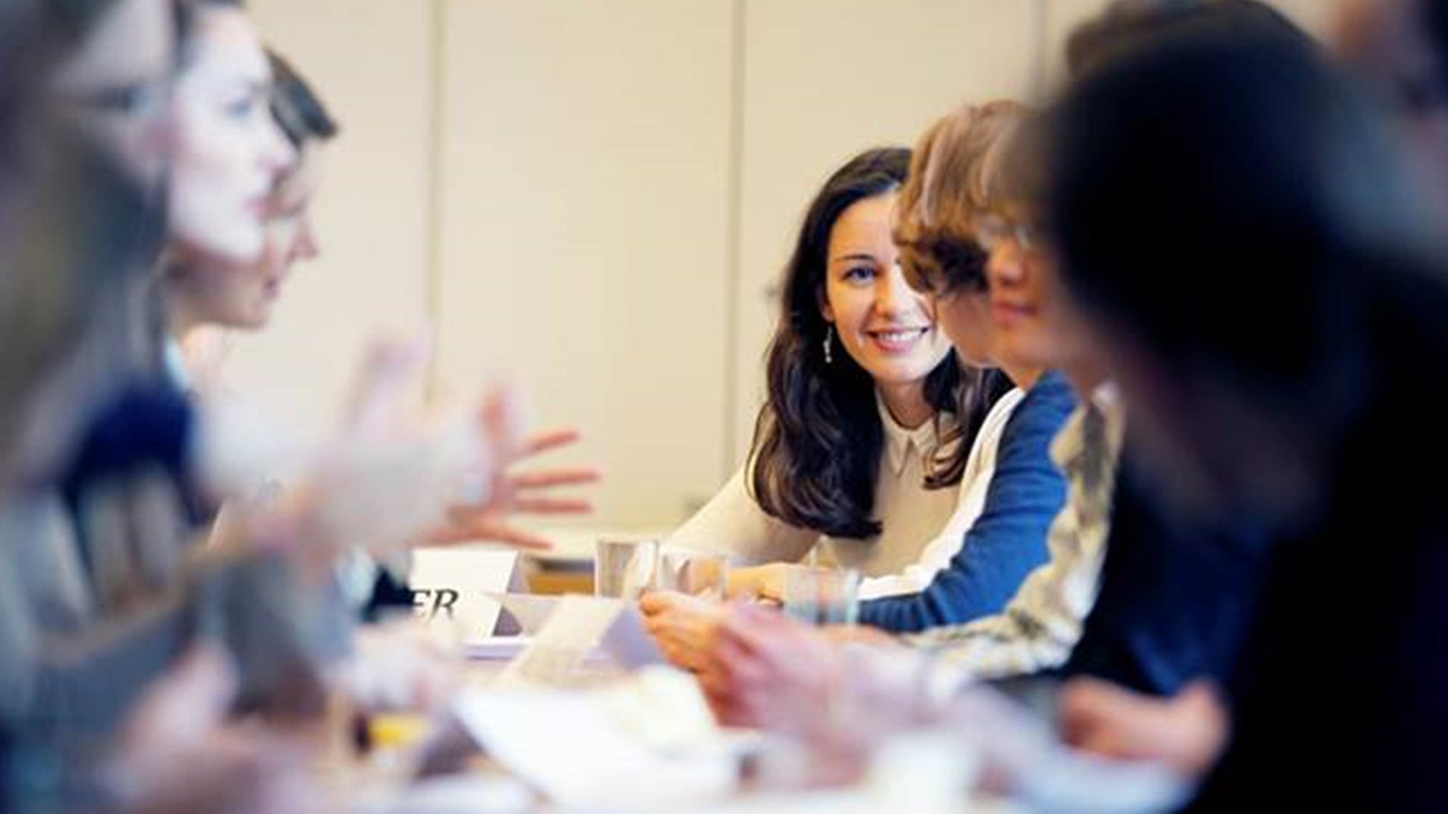
The working groups
As part of their membership, the members of die Junge Akademie | Mainz establish interdisciplinary working groups.
→ They serve to deepen a specific topic.
→ The goal is an interdisciplinary dialogue, professional
exchange and interdisciplinary cooperation.

Slide 24
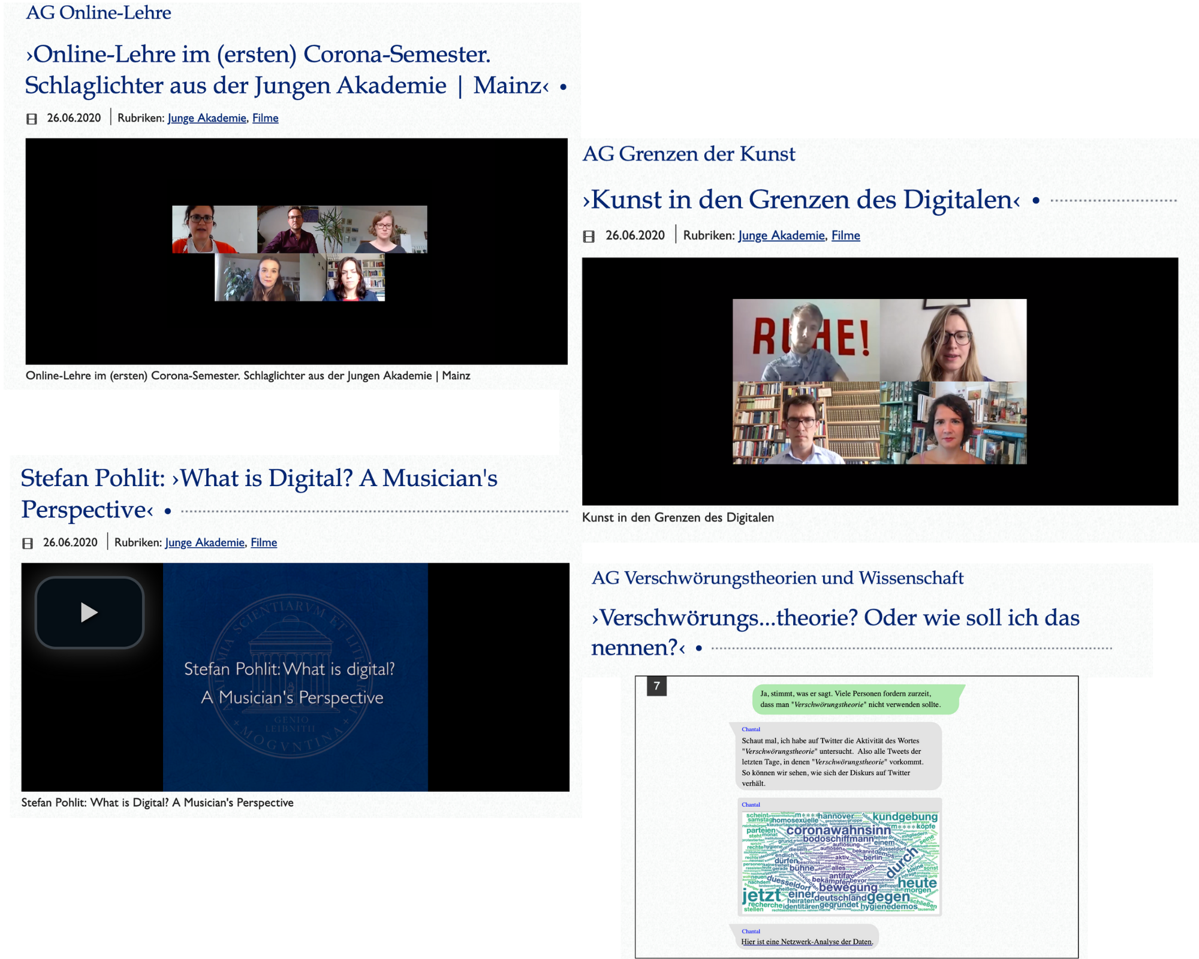
Veranstaltungsseite
›Corona und Digitalisierung‹ :
Reflexionen aus der Jungen Akademie | Mainz
26th june 2020
Where are the limits of the digitization of art and what is the importance of the pandemic-related forced digitization of university teaching?
How could a chat between a mathematician and a person worried about Corona look like?

Slide 25

Podiumsdiskussion der Jungen Akademie: »Hochschullehre im digitalen Zeitalter«
The panel discussion problematizes the conditions and possibilities of university teaching in the 21st century. It is debated on authoritative forms and principles for university teaching in the digital age.

Slide 26
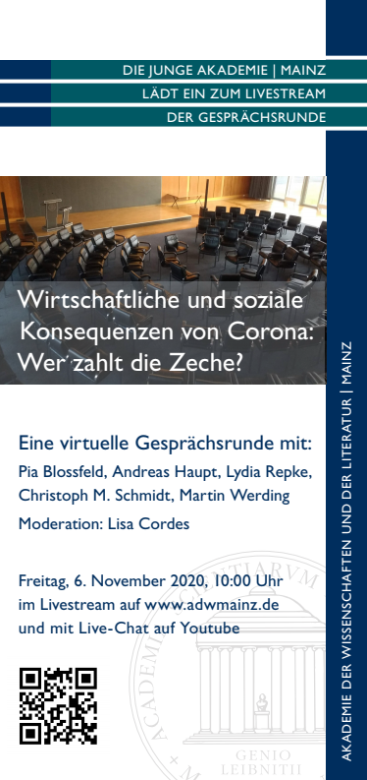
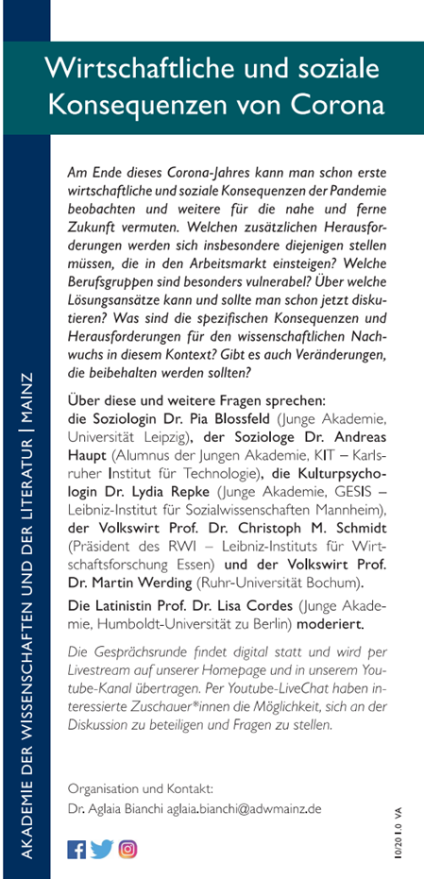
Digitale Gesprächsrunde der Jungen Akademie: ›Wirtschaftliche und soziale Konsequenzen von Corona‹
Who pays the bill?
Are there any positive changes?
What are the consequences and challenges?
Which occupational groups are particularly vulnerable?
What are the possible solutions?

Slide 27

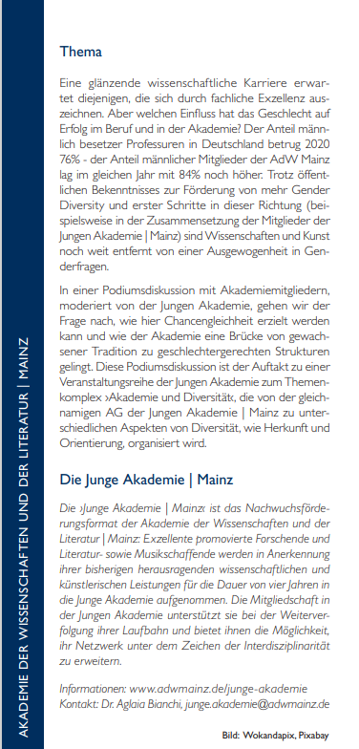
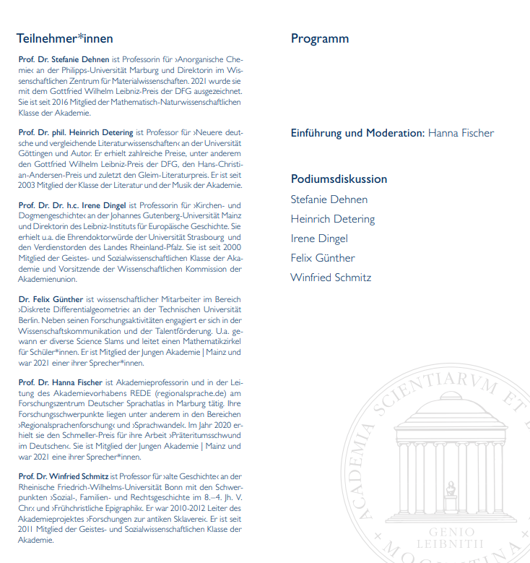
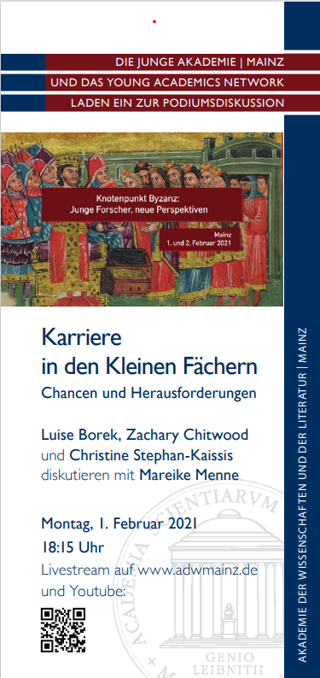
Eine Frage des Geschlechts? Chancengleichheit in der Akademie
What is the influence of gender on
success at work and in Akademie der Wissenschaften und der Literatur?

Slide 28

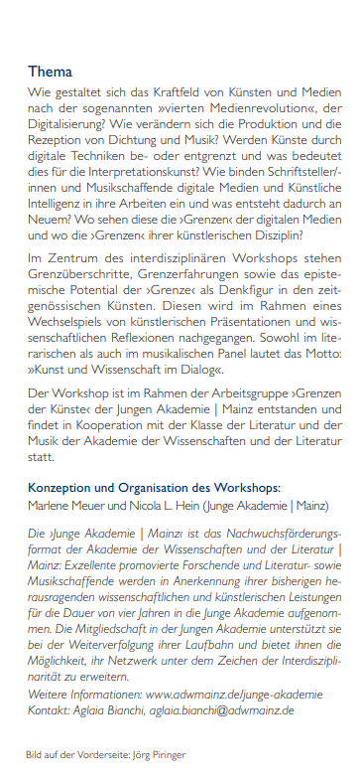
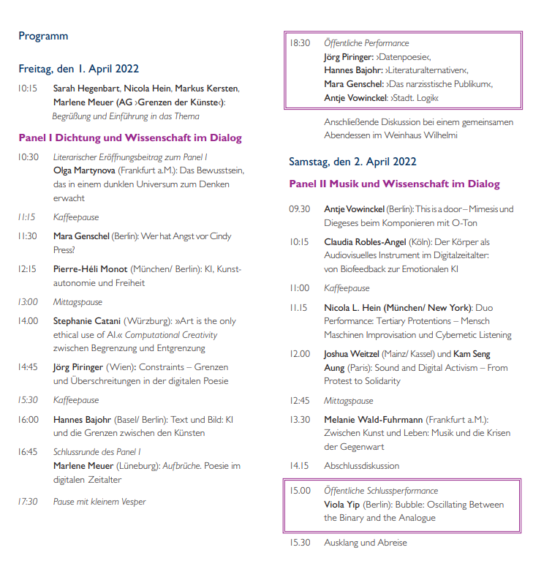
Performances: Grenzen der Künste im Zeitalter der Digitalisierung
›Grenzen der Künste‹ – this is the topic explored by the working group of the same name at Junge Akademie | Mainz not only engaged in theoretical and scientific debates, but also explored its artistic manifestations.

Slide 29
More Activities

Slide 30
Activities
Academy meeting
(Online-) Colloquium
Workshops and symposia of working groups
Reimerstage
Scientific excursions
Leading working groups in the Spring Academy of the German Academic Foundation

Slide 31
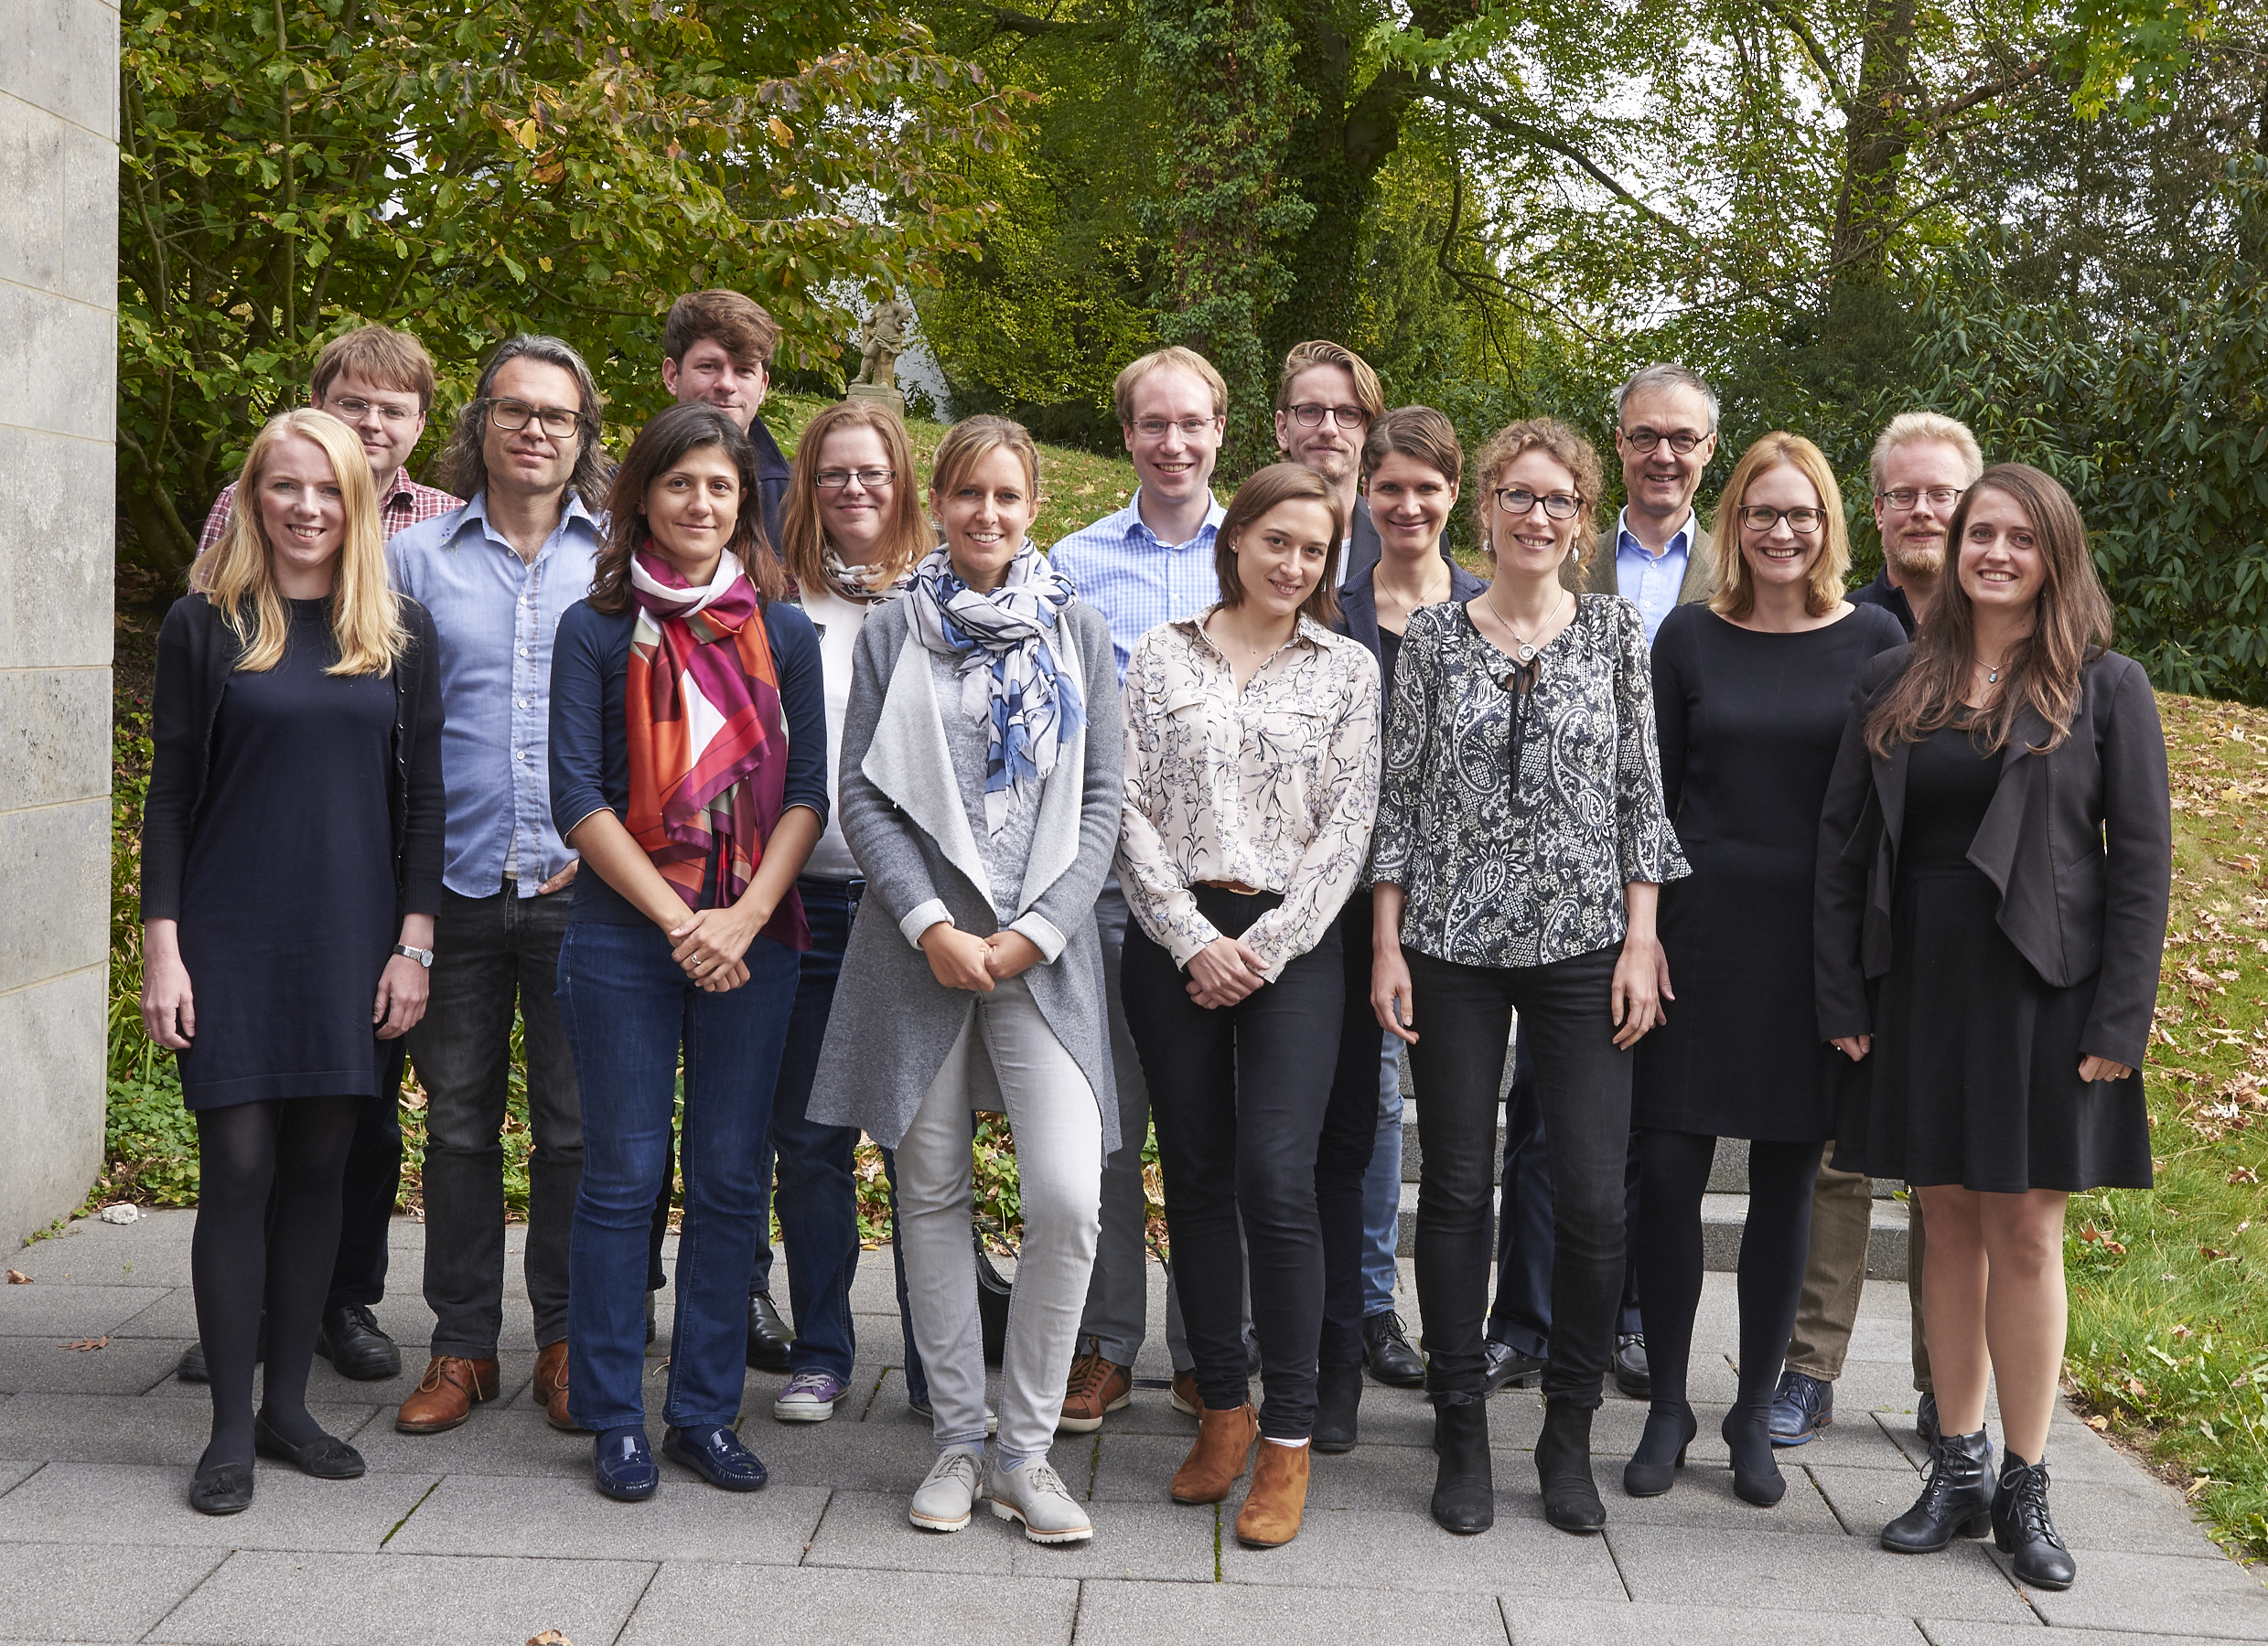
›Reimerstage der Jungen Akademie l Mainz‹
in der Werner Reimers Stiftung
28th - 29th september 2017
27th - 28th september 2018
23th - 24th january 2020
26th – 27th april 2023
In the conclave, the young scientists dedicated themselves to the discussion of scientific topics and exchanged views on current scientific issues.

Slide 32

YouTube Premiere: › JA zu Kultur‹
10th december 2020
A first encounter with authors and musicians of Junge Akademie, which enables an insight into the diversity of their literary and musical projects.

Slide 33
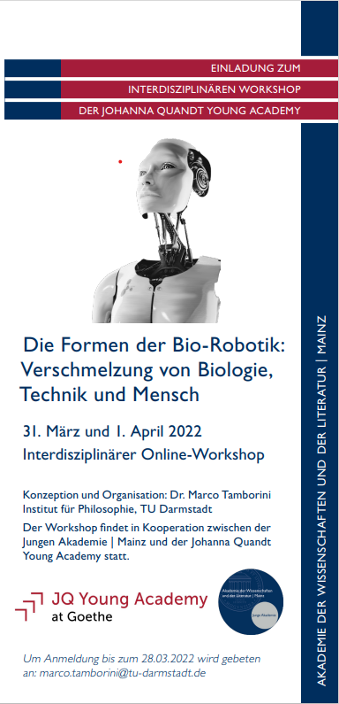
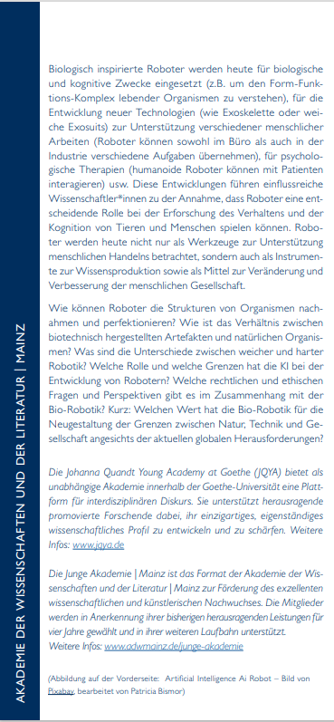
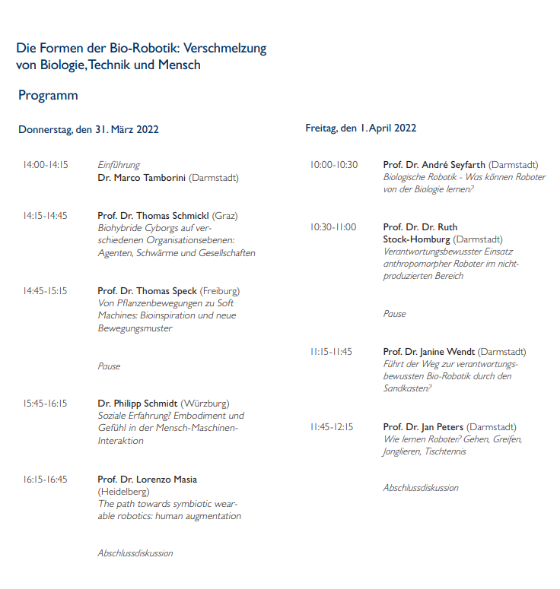
Interdisziplinärer Online-Workshop: Die Formen der Bio-Robotik - Verschmelzung von Biologie, Technik und Mensch
What is the value of bio-robotics in reshaping the boundaries between nature, technology and society in the light of current global challenges?

Slide 34
Podiumsdiskussion der Jungen Akademie: »Hochschullehre im digitalen Zeitalter«
The panel discussion problematizes the conditions and possibilities of university teaching in the 21st century. It is debated on authoritative forms and principles for university teaching in the digital age.

Slide 35
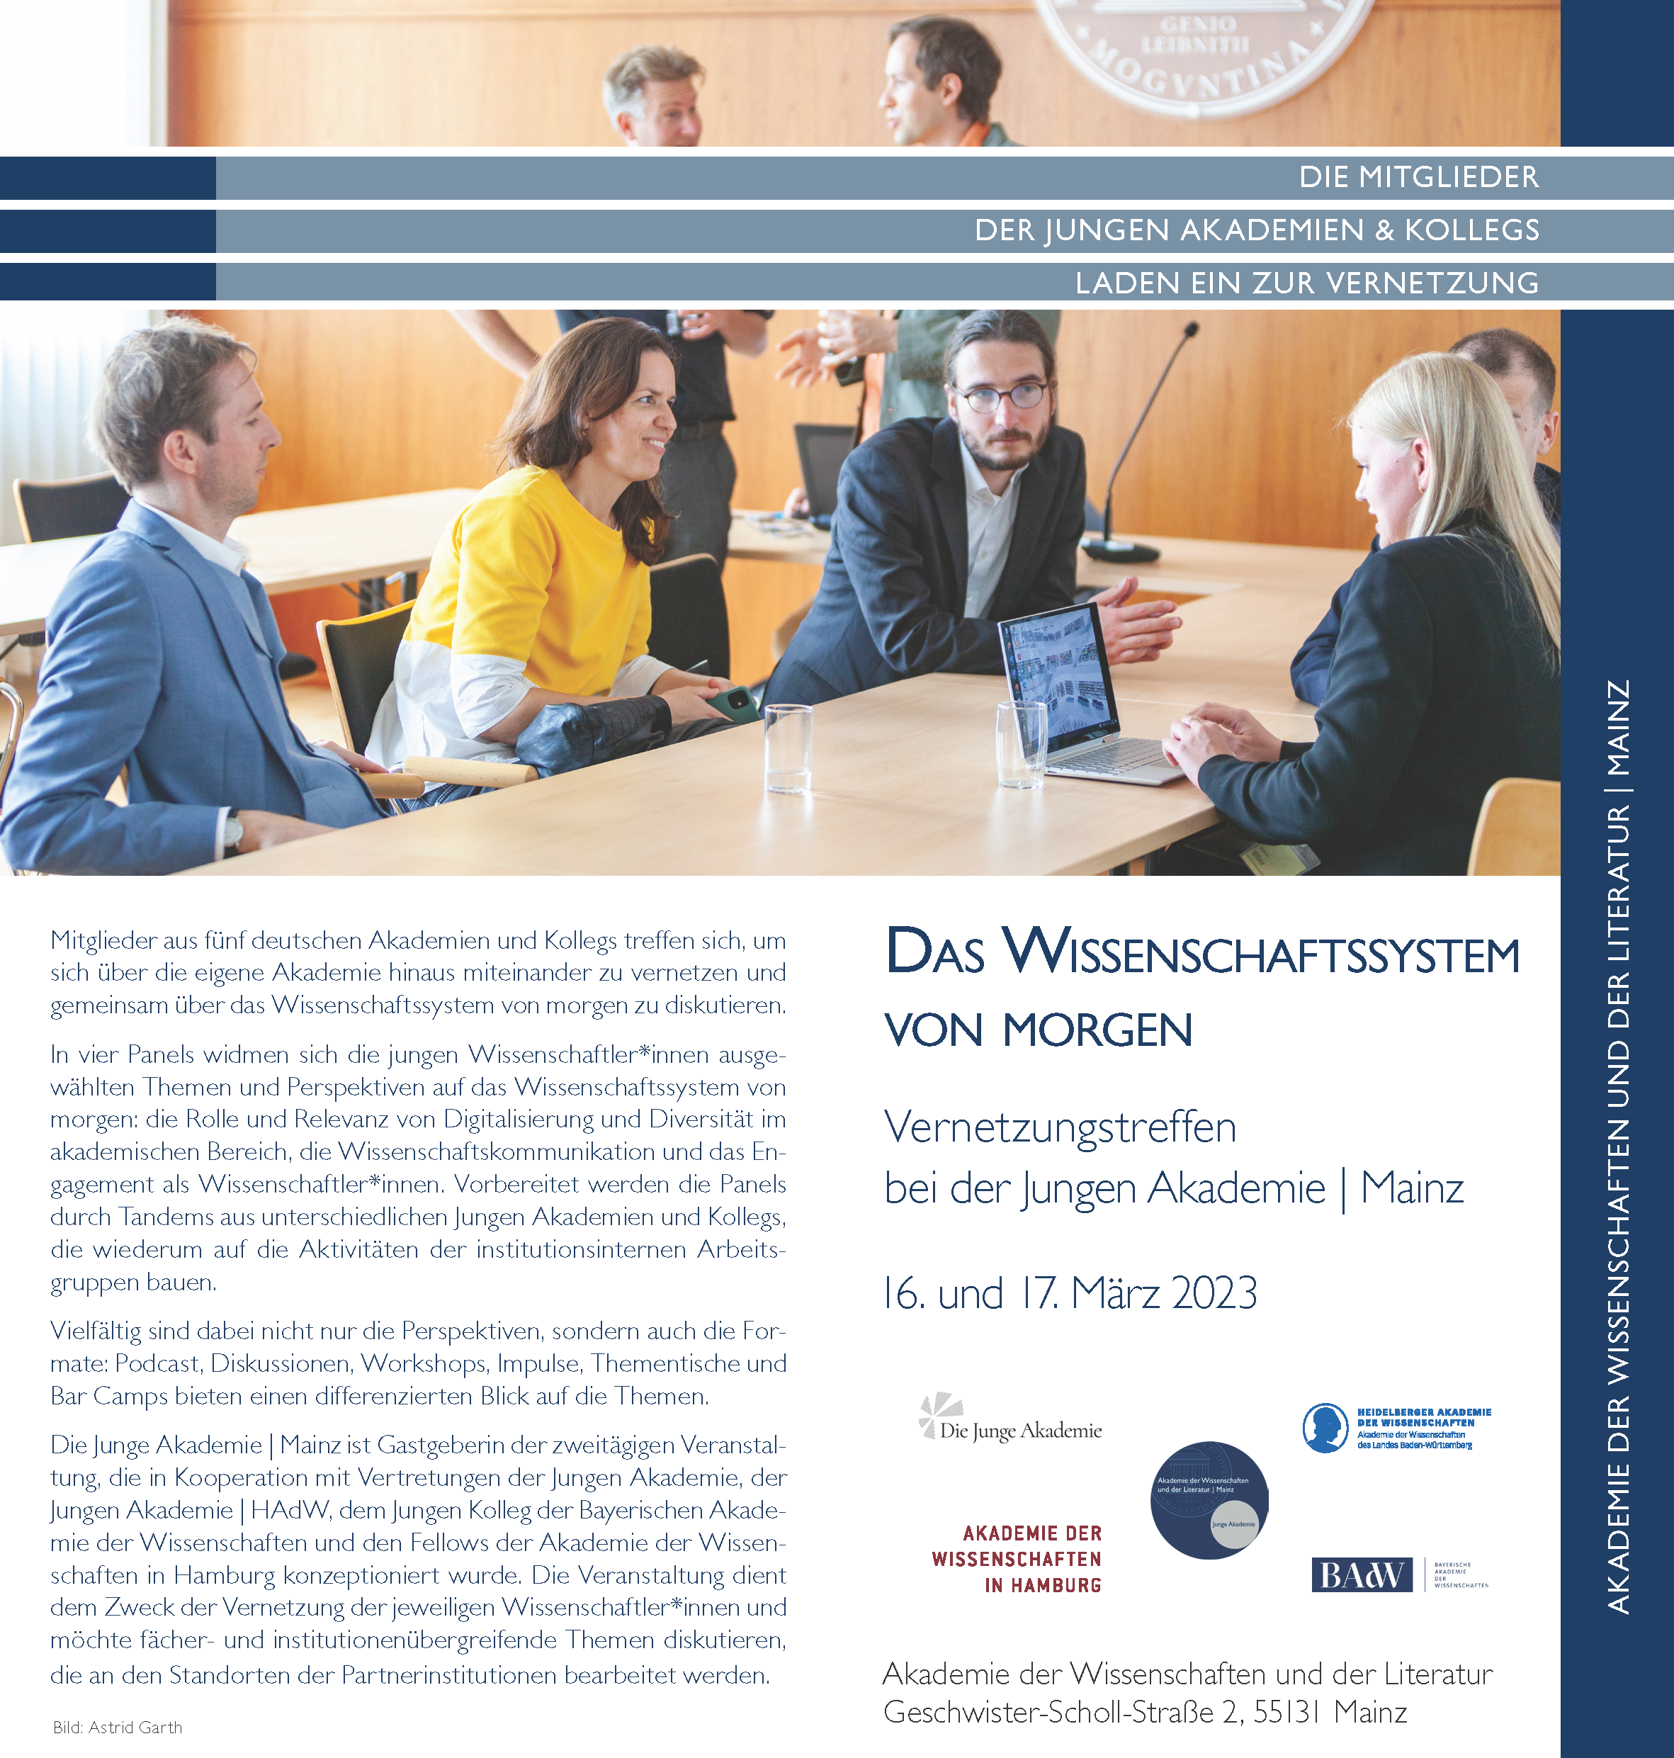
Vernetzungstreffen:
Das Wissenschaftssystem
von morgen
Members from five German academies and colleges met to network with each other beyond their own academy and to discuss the science system of tomorrow.

Slide 36
Final Remark(s)

Slide 37
Cooperation Prague | Mainz
We hope to be able to invite you to visit the Junge Akademie | Mainz in the near future.
Don‘t hesitate and talk to:
Aglaia Bianchi,
Kristina Lippmann,
or me!

Slide 38
picture credits
Dr. Jennifer Automo: Manuel Debus
Dr. Patrick Bettinger: Valéry Kloubert
Dr. Pia Blossfeld: F. Kley
Dr. Luise Borek: privat
Dr. Paul Breiding: Özde Bayer
Jun.-Prof Dr. Sarah Burnautzki: Maria Lubiana
Paul-Henri Campell: Volker Derlath
Elisabeth Champollion: Aleksandra Renska
Jun.-Prof. Dr. Eva von Contzen: Universität Freiburg
Jun.-Prof. Dr. Lisa Cordes: Anna Olivia Weimer
Julia Désirée Eisentraut: privat
Dr. Chiara Ferella: privat
PD Dr. Hanna Fischer: Andrian Sandha
Dr. Felix Günther: Studioline Photography
Juan Sebastian Guse: Daria Brabanski
Dr. Sarah Hegenbart: Emmanuel Oyeleke
Nicola Leonard Hein: Beate Steil
Dr. Jonas Hoch: privat
Dr. Andrea Hofmann: Angelika Stehle
Paul Hübner: Paula Vidal
Dr. Markus Kersten: Uni Basel
Jun.-Prof. Dr. Kristina Köhler: Hermann Recknagel
Dr. Christine Lang: Martin Funk
Dr. Sophie Lohmann: MPI/ Fotostudio Hagedort
Dr. Friederike Lorenz: privat
Dr. Benjamin Loy: privat
PD Dr. med. Melanie Meersch-Dini: UKM/ Fotozentrale
Dr. Sebastian Meixner: privat
Dr. Marlene Meuer: privat
Dr. Niels Penke: privat
Dr. Stefan Pohlit: privat
Dr. Lydia Repke: Elia Soler
Dr. Torben Riel: S. Tränkner/ Senckenberg
Ass.-Prof. Dr. Lic. Christian Rößner: privat
Dr. Hanieh Saeedi: privat
Miriam Rachel Salzmann: privat
Prof. Dr.-Ing. Stefan Schafföner
Dr. Sebastian M. Spitra: Miloš Vec
Tamara Štajner: Andrej Grlic
Dr. Sören Stumpf: privat
Dr. Marco Tamborini: Hwa Ja Götz, MfN
Dr. Jens Temmen: privat
Dr. Christoffer Theis: privat
Dr. Antonino Tranchina: Barbara Herrenkind
Dr. Veronika Unger: privat
Dr. Eugen Wassiliwizky: privat
Anna Weidenholzer: katsey
Dr. Tobias C. Weißmann: privat
Dr. Lena Wetenkamp: Thomas Hartmann
Dr. Staphanie Willeke: Kirsten Hötger
Hintergrund Die Institution: Walter Vorjohann
Hintergrund Die Arbeitsgruppen: Sven Paustian
Clemens Hoch: Staatskanzlei RLP / Sämmer
Cover der Publikationen: Franz Steiner Verlag
Deutschland: David Liuzzo, https://commons.wikimedia.org/wiki/File:Karte_Deutschland.svg
Karte Italien: https://pixabay.com/de/vectors/italien-karte-land-geographie-153961/
Karte Österreich: https://pixabay.com/de/illustrations/%C3%B6sterreich-karte-bundesl%C3%A4nder-2434253/
Karte Schweiz: https://pixabay.com/de/illustrations/schweiz-karte-kantone-unbeschriftet-2434255/
Pins: Mono, https://commons.wikimedia.org/wiki/File:Map_pin_icon.svg
Foto Reimerstage: Stefanie Wetzel
Flyer Mainzer Poetikdozentur mit Philipp Schönthaler: Sven Paustian
Flyer Mainzer Poetikdozentur mit Ulrike Almut Sandig: Wolfgang Frank
Flyer Symposium der Jungen Akademie l Mainz: ›Justiz Macht Politik‹: Jasper Kunstreich
Flyer ›Brexit means Brexit?‹ A Symposium: Logo: Detail of the Oilpainting ›Hell is empty, and all the devils are here‹ (2017) by José García y Más (www.mas-art.de)
Flyer Workshop der Jungen Akademie l Mainz: ›Sprache Macht Magie‹: D. Müller
Flyer 2. Mainzer Science Week: ›Mensch und Mobilität‹: Mainzer Wissenschaftsallianz
Flyer Tagung: ›Scheitern in der Gelehrtenkultur der Frühen Neuzeit‹: Zur Geographie. Schiffbruch bey einem Seesturm / Daniel Chodowiecki [Illustr.]. Johann Conrad Krüger [Stecher]. D: Chodowiecki del J. C. Krüger sc. Berol. [Sign.]. Quelle: Pictura Paedagogica OnlinKarte

Slide 39
Akademie der Wissenschaften und der Literatur | Mainz
Geschwister-Scholl-Straße 2
55131 Mainz
+49/6131/577-0
www.adwmainz.de
The assignment of the picture credits and the naming of the photographers was done to the best of our knowledge and is partly based on information provided by the members themselves. Additional information is requested to be sent to the Academy of Sciences and literature.

